Slide 1
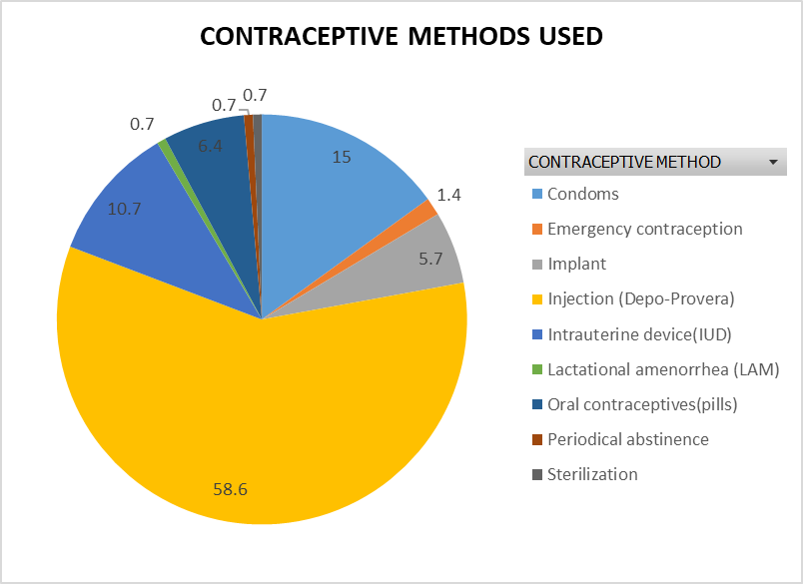
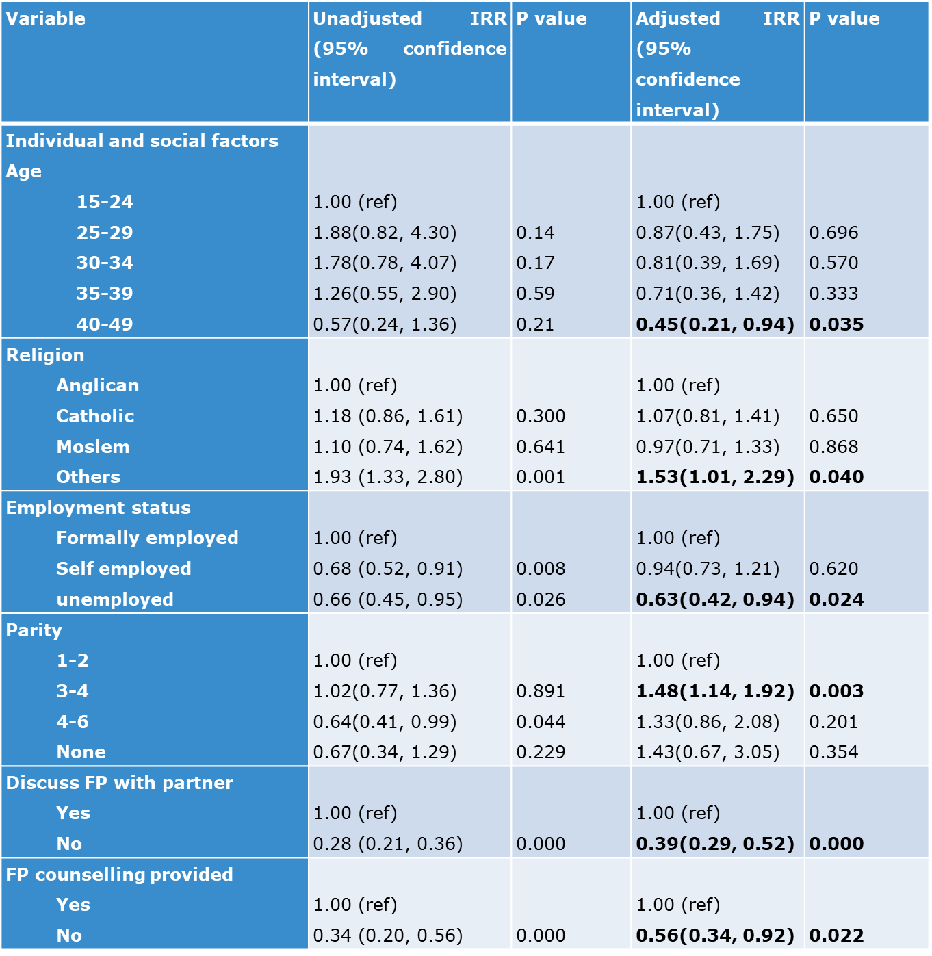
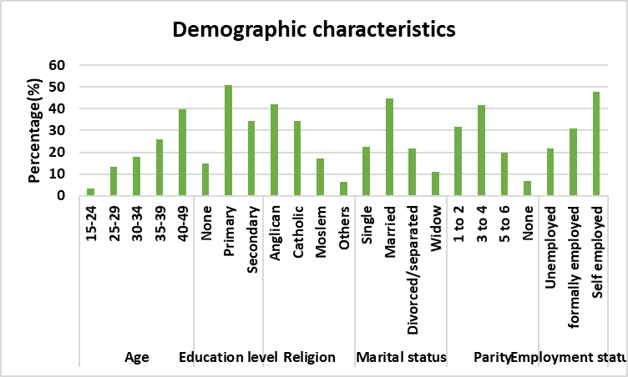
CONTRACEPTION UPTAKE AMONG HIV POSITIVE WOMEN ON DOLUTEGRAVIR-BASED ANTIRETROVIRAL TREATMENT IN URBAN UGANDA.
Leah Mbabazi, Mariah Sarah Nabaggala, Shadia Nakalema, Abdallah Kamira, Eva Laker, Stephen Okoboi, Barbara Castelnuovo, Agnes Kiragga, Mohammed Lamorde.
Infectious Diseases Institute (IDI) Makerere University College of Health Sciences, Kampala-Uganda.
INTRODUCTION
WHO recommended dolutegravir (DTG) as preferred first line ART in 2016 ³.
A study in Botswana reported 0.94% (4/426) risk of DTG causing congenital anomalies in 2018 ².
This resulted in WHO:
Issuing a teratogenicity alert for women using DTG In May 2018 ¹.
Calling for integration of sexual and reproductive services into HIV care.
Data on the impact of this guidance on contraceptive uptake among HIV positive women is scarce especially in resource limited settings.
AIM
To assess contraceptive uptake and its associated factors among HIV positive women on DTG-based regimen in urban Uganda.
METHODOLOGY
Cross-sectional study from May 2019 to July 2019.
Study area: 5 public HIV clinics supported by Infectious Diseases Institute(IDI) in Kampala.
Randomly selected non-pregnant women (aged 15-49 years) who used DTG-based regimens.
METHODOLOGY CONTINUED
Data was collected using interviewer administered questionnaires.
Data collected included demographics, contraceptive use, social and health system factors.
STATISTICAL ANALYSIS
Data analysis using STATA version 14.
Descriptive statistics to summarize patient characteristics.
Poisson regression model to analyze factors associated with contraceptive uptake.
RESULTS
359 women included in the study
Mean age (SD) was 37(6.8) years
Contraceptive uptake was 138(38.4%), majority 82/138(58.6%) preferred injectable. method.
RESULTS CONTINUED
Factors with Increased Incidence Risk Ratio (IRR): religion, parity, FP counselling and discussion of FP with partner.
Table: factors associated with contraceptive use
;
CONCLUSION
Low uptake of contraceptives
Injectable contraception was the most used contraceptive.
Contraceptive counselling and partner discussion on contraception increased the contraceptive uptake.
RECOMMENDATIONS
Scale up integration of contraceptive services into HIV care and management programs.
Increase male involvement in family planning programs.
Figure showing couple counselling on contraceptive use.
ACKNOWLEGEMENT
IDI clinic is supported by funding from the Government of Uganda (GR-G-0902) and the Presidents Emergency Plan for AIDS Relief through the United States Centers for Disease Control (NU2GGH002022)
REFERENCES
WHO. (2018). WHO Statement on DTG [Press release]. Retrieved from https://www.who.int/medicines/publications/drugalerts/Statement_on_DTG_18May_2018final.pdf
Zash, R., Makhema, J., & Shapiro, R. L. (2018). Neural-Tube Defects with Dolutegravir Treatment from the Time of Conception. New England Journal of Medicine, 379(10), 979-981. doi:10.1056/NEJMc1807653
WHO. (2016). Consolidated guidelines on the use of antiretroviral drugs for treating and preventing HIV infection. Retrieved from Geneva:
S-106588
PRESENTED AT THE 23RD INTERNATIONAL AIDS CONFERENCE (AIDS 2020) | 6-10 JULY 2020

